Slide 2
Who do you think we are?
Bad news . . . Good news

Slide 3
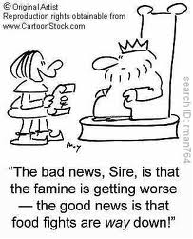

Slide 5
Ephesians 2:1-3
1 As for you, you were dead in your transgressions and sins, 2 in which you used to live when you followed the ways of this world and of the ruler of the kingdom of the air, the spirit who is now at work in those who are disobedient.

Slide 6
Ephesians 2:1-3
3 All of us also lived among them at one time, gratifying the cravings of our flesh and following its desires and thoughts. Like the rest, we were by nature deserving of wrath

Slide 7
Ephesians 2:1-3
The Message
It wasn’t so long ago that you were mired in that old stagnant life of sin. You let the world, which doesn’t know the first thing about living, tell you how to live. You filled your lungs with polluted unbelief, and then exhaled disobedience.

Slide 8
Ephesians 2:1-3
The Message
We all did it, all of us doing what we felt like doing, when we felt like doing it, all of us in the same boat. It’s a wonder God didn’t lose his temper and do away with the whole lot of us

Slide 9
The Good news is . . .

Slide 10
Ephesians 2:4-9
4 But because of his great love for us, God, who is rich in mercy, 5 made us alive with Christ even when we were dead in transgressions—it is by grace you have been saved. 6 And God raised us up with Christ and seated us with him in the heavenly realms in Christ Jesus,

Slide 11
Ephesians 2:4-9
7 in order that in the coming ages he might show the incomparable riches of his grace, expressed in his kindness to us in Christ Jesus. 8 For it is by grace you have been saved, through faith—and this is not from yourselves, it is the gift of God— 9 not by works, so that no one can boast

Slide 12
Ephesians 2:4-9
The Message
Instead, immense in mercy and with an incredible love, he embraced us. He took our sin-dead lives and made us alive in Christ. He did all this on his own, with no help from us! Then he picked us up and set us down in highest heaven in company with Jesus, our Messiah.

Slide 13
Ephesians 2:4-9
The Message
Now God has us where he wants us, with all the time in this world and the next to shower grace and kindness upon us in Christ Jesus. Saving is all his idea, and all his work. All we do is trust him enough to let him do it.

Slide 14
Ephesians 2:4-9
The Message
It’s God’s gift from start to finish! We don’t play the major role. If we did, we’d probably go around bragging that we’d done the whole thing! No, we neither make nor save ourselves. God does both the making and saving

Slide 15
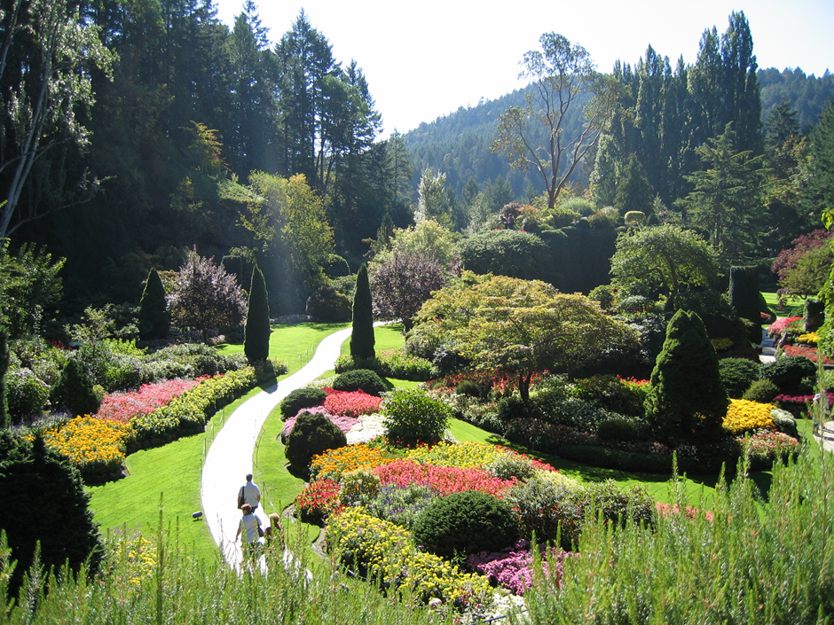

Slide 16
We are God’s garden of restored people

Slide 17
4 But because of his great love for us, God, who is rich in mercy, 5 made us alive with Christ even when we were dead in transgressions—it is by grace you have been saved.
Pictures of mercy and grace

Slide 18
6 And God raised us up with Christ and seated us with him in the heavenly realms in Christ Jesus,
7 in order that in the coming ages he might show the incomparable riches of his grace, expressed in his kindness to us in Christ Jesus.

Slide 19
For it is by grace you have been saved, through faith—and this is not from yourselves, it is the gift of God— 9 not by works, so that no one can boast

Slide 20
10 For we are God’s handiwork, created in Christ Jesus to do good works, which God prepared in advance for us to do.
Good news:
Who we are
Our purpose

